Slide 1


Sun

Slide 2

Sky

Slide 3

Cloud

Slide 4

Moon

Slide 5

Star

Slide 6
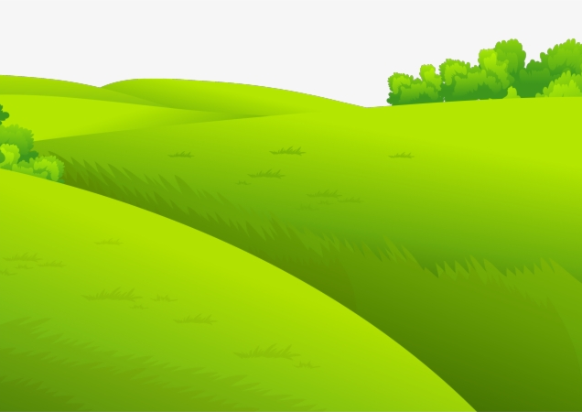
Grass

Slide 7
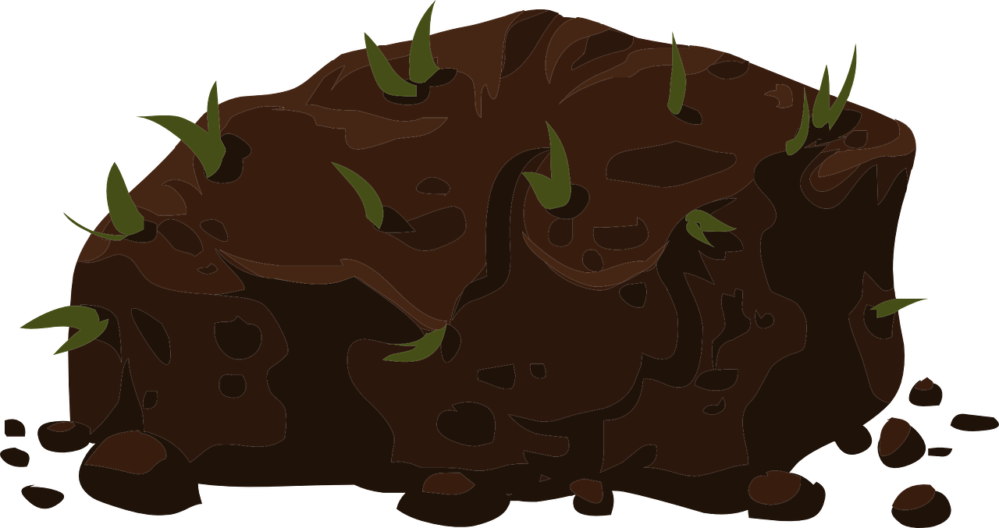
Soil

Slide 8

Sand

Slide 9
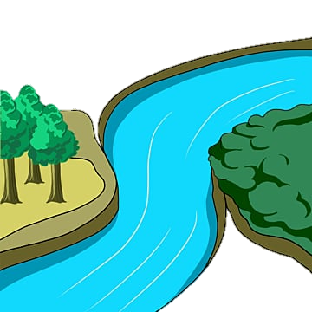
River

Slide 10

Sea

Slide 11

Wind

Slide 12
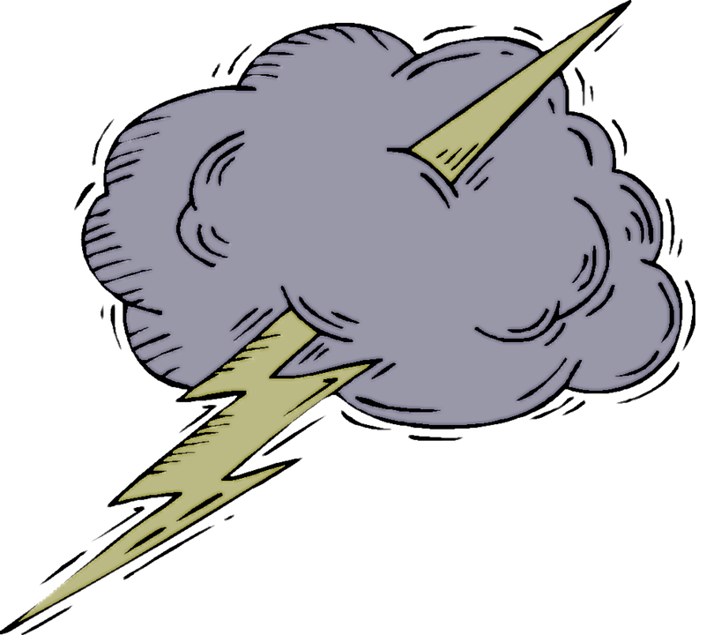

Storm

Slide 13

Rain

Slide 14

Snow

Slide 15
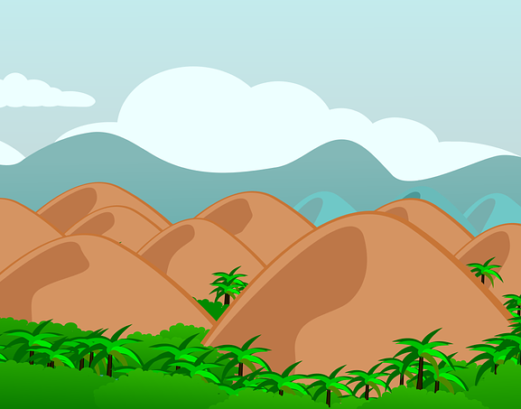
Hill

Slide 16

Mountain

Slide 17

Tree

Slide 18
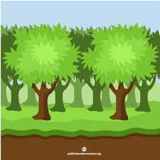
Forest

Slide 19

Flower

Slide 20

Fruit

Slide 21

Birds

Slide 22
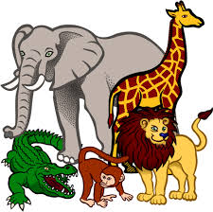
Animals

Slide 23

Insects

Slide 24
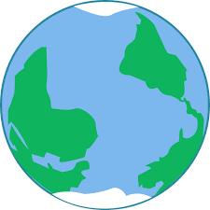
Earth

